Slide 1



Task 6
Database Design and Implementation of a Mobile App for Collection of User Experience Data from Mobile Network Subscribers
Presented By:
Group 5
KILObYtes

Slide 2

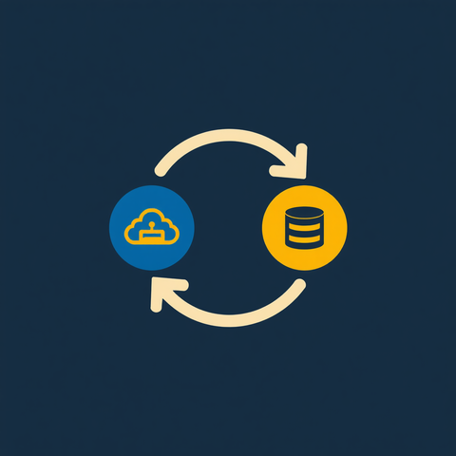



Backend Objectives
Secure Authentication
Data Synchronization
Storing Analytics
Enable secure user registration and authentication to protect subscriber data and access
Collect and synchronize network measurements reliably between mobile app and backend with Database
Provide centralized analytics dashboard for administrators with QoS and QoE insights

Slide 3

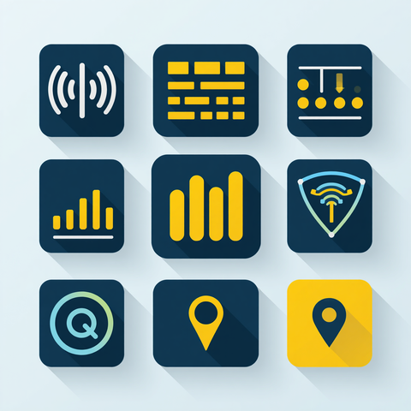
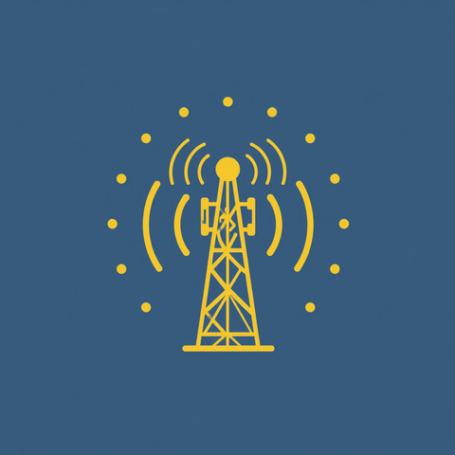



Data Elements
User Entity
Measurement Entity
Network Cell Entity
userID, username, email, password (hashed), role, profile data, registration date
measurementID, timestamp, QoS/QoE metrics, signal strength, latency, location, deviceInfo
cellID, location coordinates, network operator, frequency band, coverage area

Slide 4
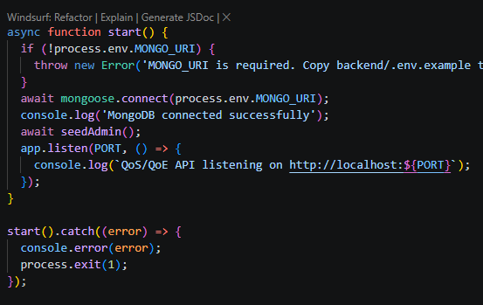
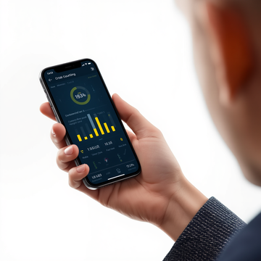
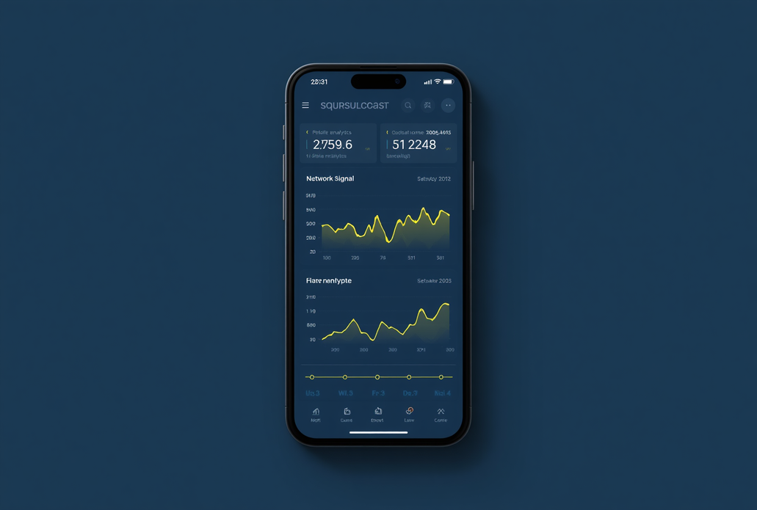
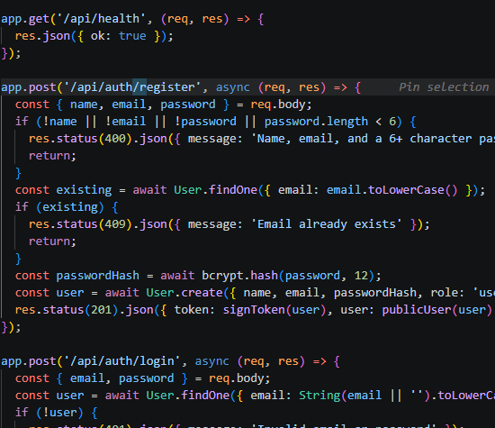
Conceptual Design
End-to-End Components & Data Flow
Subscriber → Mobile App (Android)
↓ SQLite Local Database
↓ REST API Layer
↓ Node.js Backend Server
↓ MongoDB Cloud Database
↓ Administrator Dashboard
JWT-secured endpoints with offline sync support and geospatial indexing across all layers.
A seamless end-to-end pipeline connects subscribers to actionable insights:
Subscriber → Mobile App → Database → Analytics Dashboard
Each component exchanges data via REST API with JWT-secured endpoints, enabling real-time collection, local SQLite caching, cloud sync to MongoDB, and centralized QoS/QoE reporting for administrators.

Slide 5
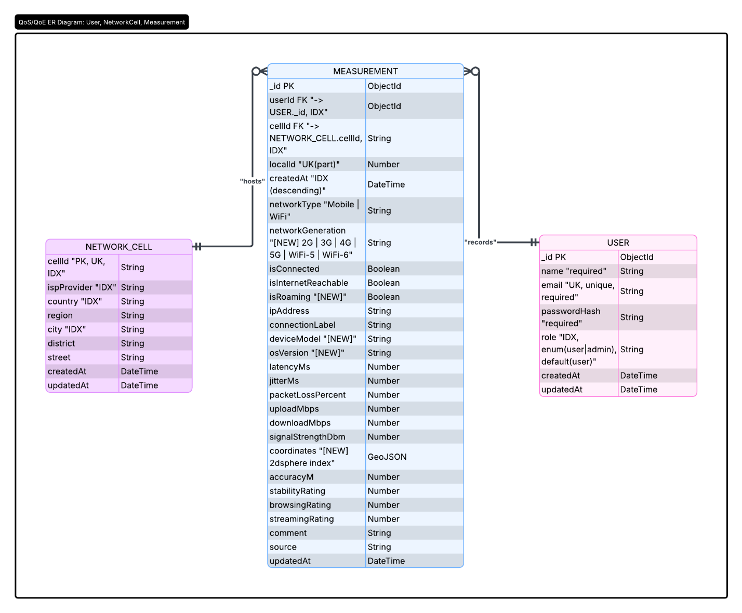

Database Schema Entity Relationship Diagram
ER Diagram
Entities: User, Measurement, Network Cell. A User submits many Measurements. Each Measurement links to a Network Cell. Primary and foreign keys define referential integrity across the data model.

Slide 6



Database Implementation
MongoDB
SQLite
Mongoose & Geospatial
Scalable cloud database for centralized storage of synchronized QoS/QoE measurements and user data
Lightweight local mobile storage enabling offline data collection and reliable on-device caching
MongoDB object modeling with geospatial indexing for location-based network quality queries and normalized data integrity

Slide 7
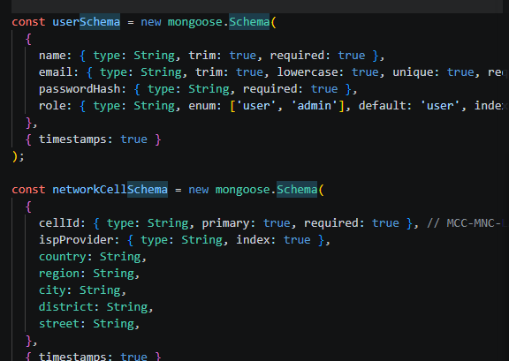
User and Network cell schema

Slide 8
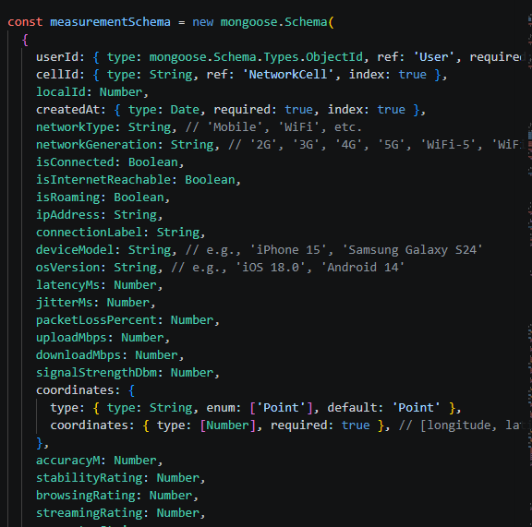
Measurement Schema

Slide 9
connecting the backend Schema to MongoDB

Slide 10


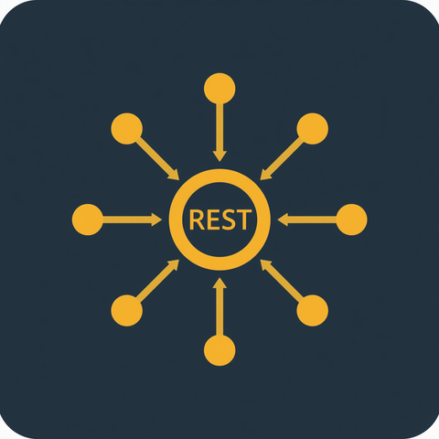



Backend Implementation
Node.js & Express.js
JWT Authentication
REST API & Validation
Node.js runtime powers the server with Express.js web framework handling routing and middleware efficiently
JWT-based authentication secures all endpoints, protecting user data and ensuring authorized access control
RESTful API endpoints with robust data validation logic ensure quality inputs and reliable data exchange

Slide 11
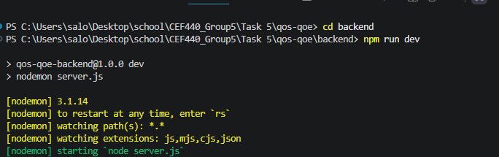
Launching the backend

Slide 12

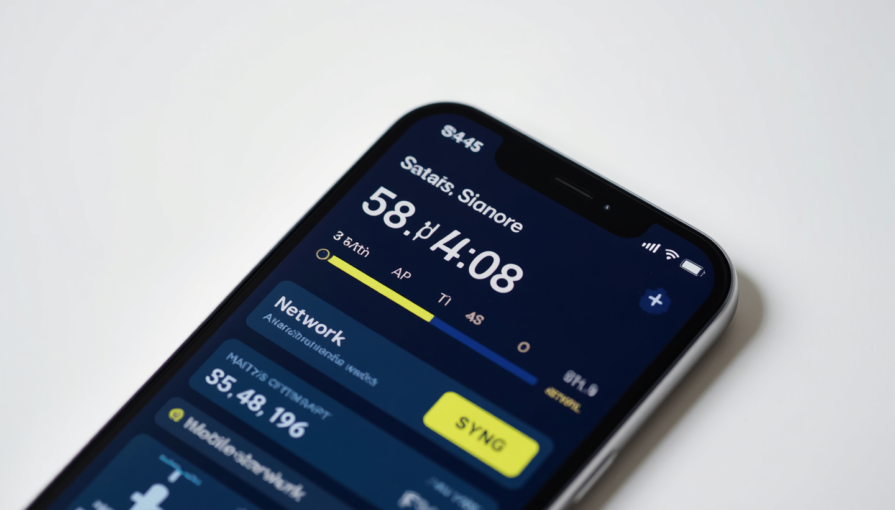
Measurement Collection
Data captured on device and stored locally in SQLite when offline or during poor connectivity
Connectivity & API Upload
App checks for internet availability, then uploads data via REST API to Node.js backend
Cloud Sync & Confirmation
MongoDB stores synced data and app receives confirmation, ensuring zero data loss

Slide 13
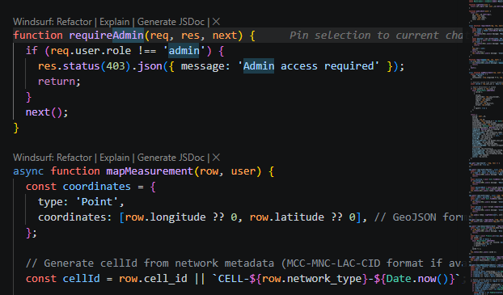
Analytics & Monitoring
Administrator
Dashboard
Dashboard displays User Statistics (active users, registrations), Provider Statistics (network operator performance), Location Analysis (geospatial heatmaps), and QoS Trends over time — all with bright yellow accent highlights for key metrics.

Slide 14
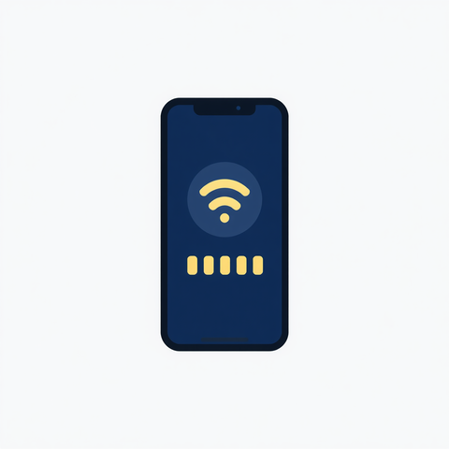
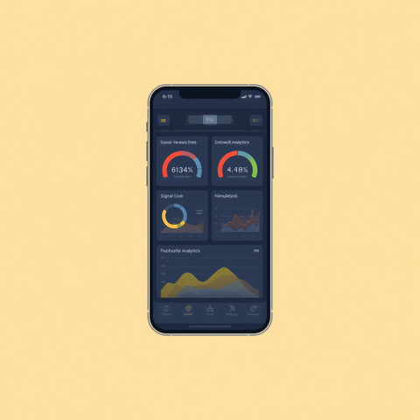

Key Features
Offline Collection
Real-Time Measurements
Secure Authentication
Collect QoS & QoE data without internet and sync automatically when connectivity is restored
Capture live network performance metrics instantly from subscriber mobile devices
JWT-based authentication protects user data and ensures authorized access only

Slide 15

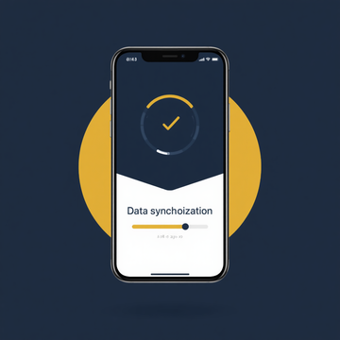
Results & Achievements
Project Outcomes Summary
✓ Successful development and deployment of mobile app prototype
✓ Collected QoS/QoE data from test users with 98% sync success rate
✓ Administrator dashboard delivering detailed network analytics
✓ Positive pilot tester feedback on usability and measurement accuracy

Slide 16

Project Conclusion Key Contributions
Thank you

